Slide 1
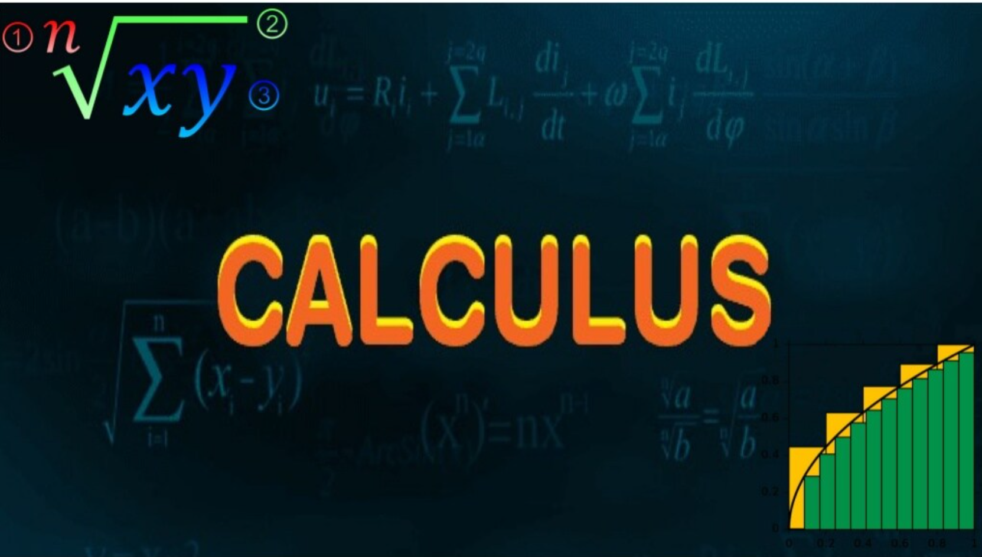

Slide 2
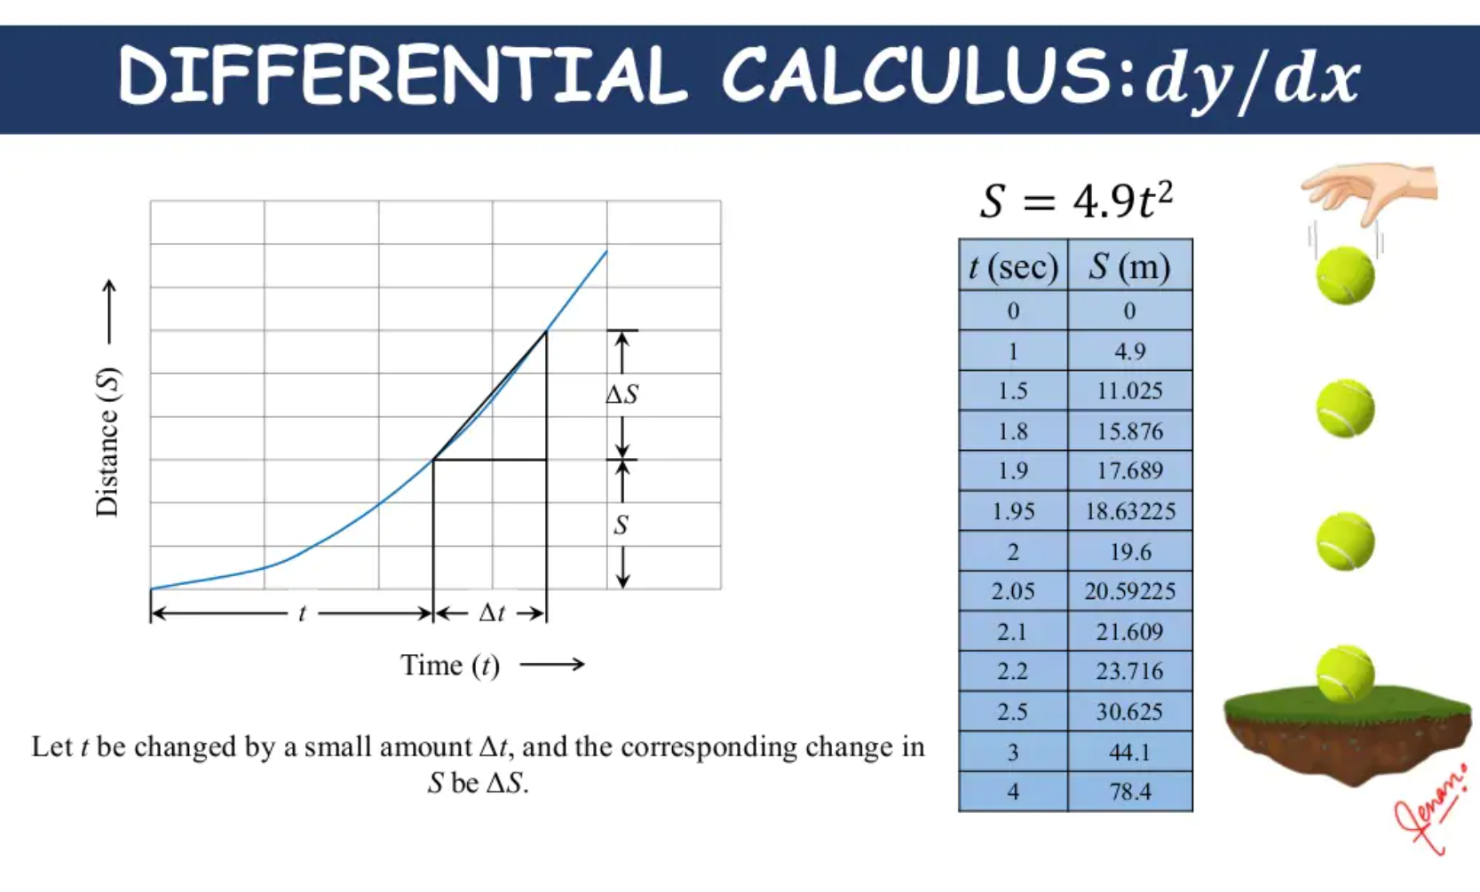

Slide 3
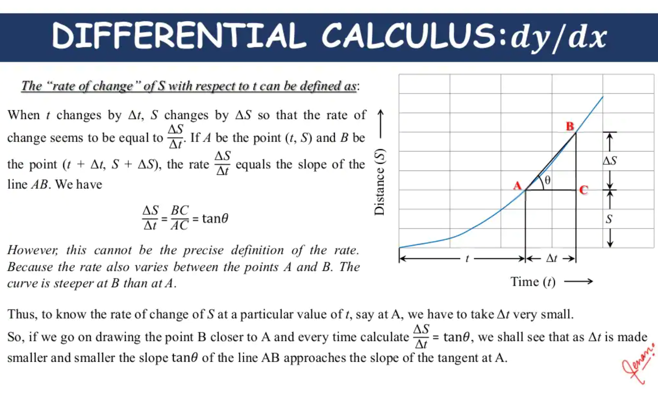

Slide 4
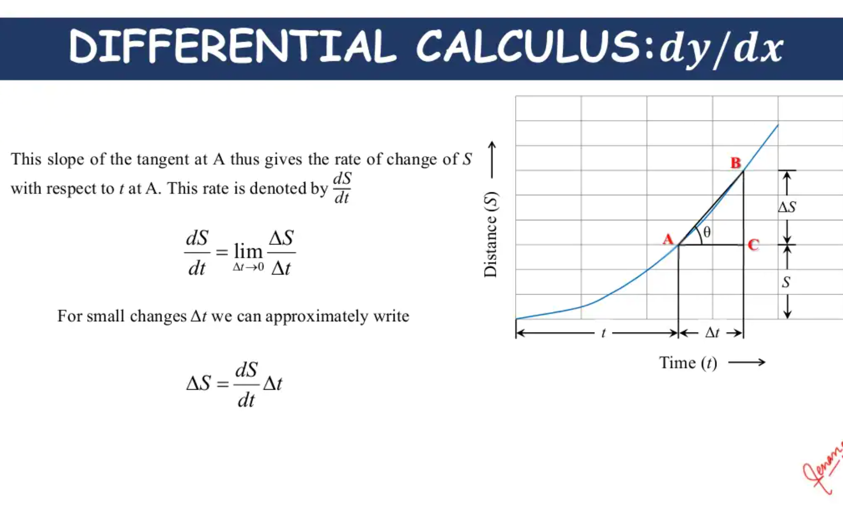

Slide 5
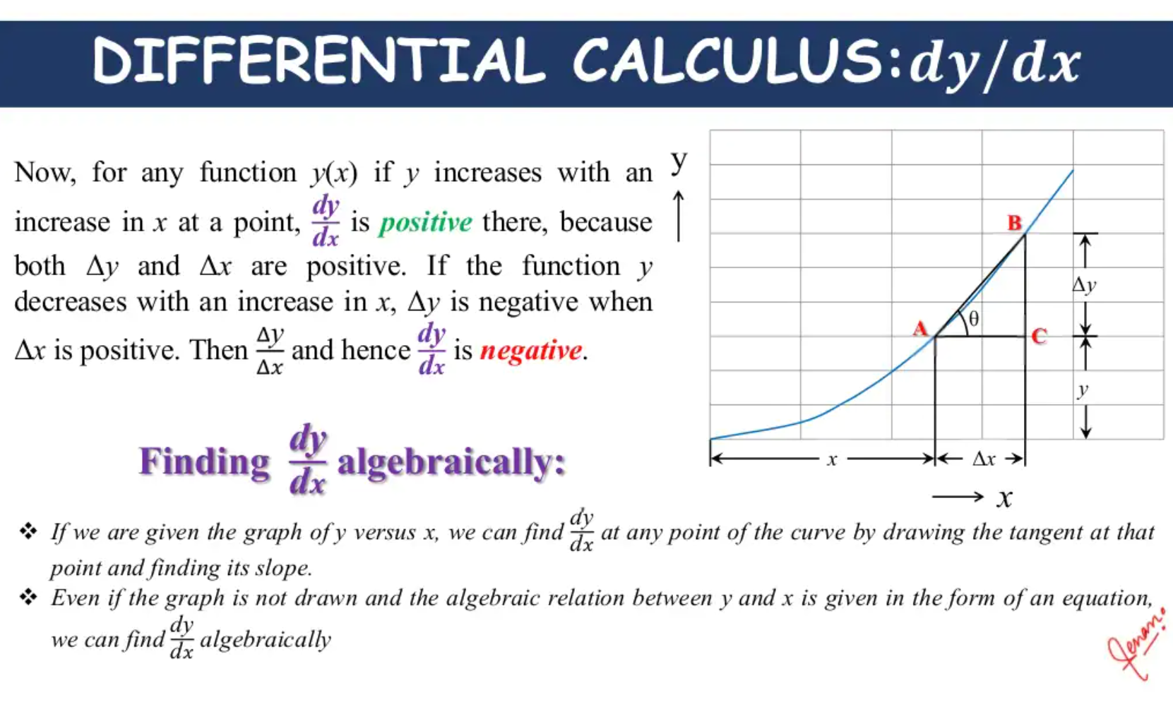

Slide 6
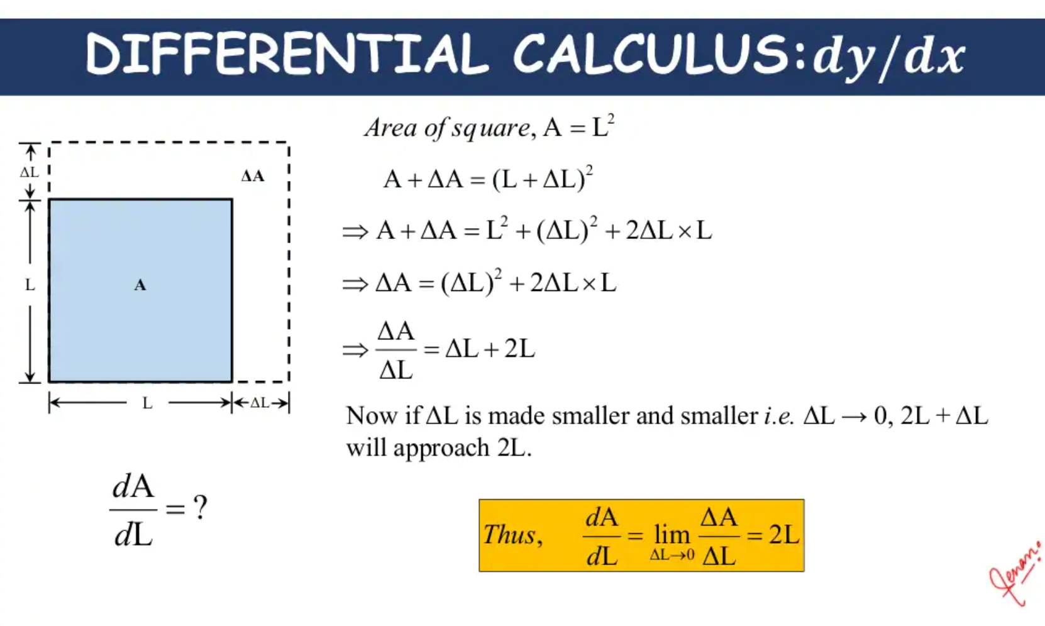

Slide 7
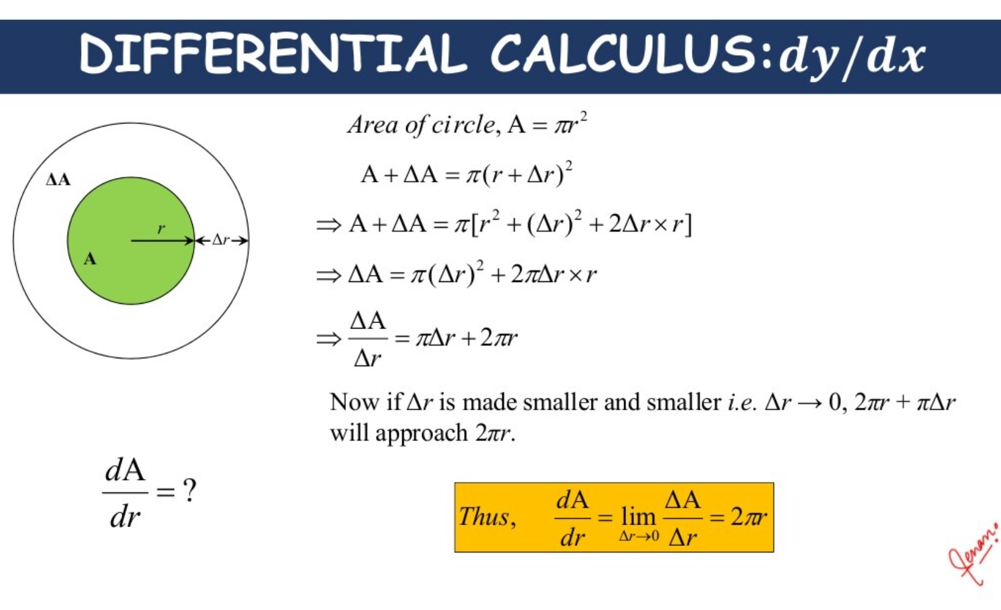

Slide 8
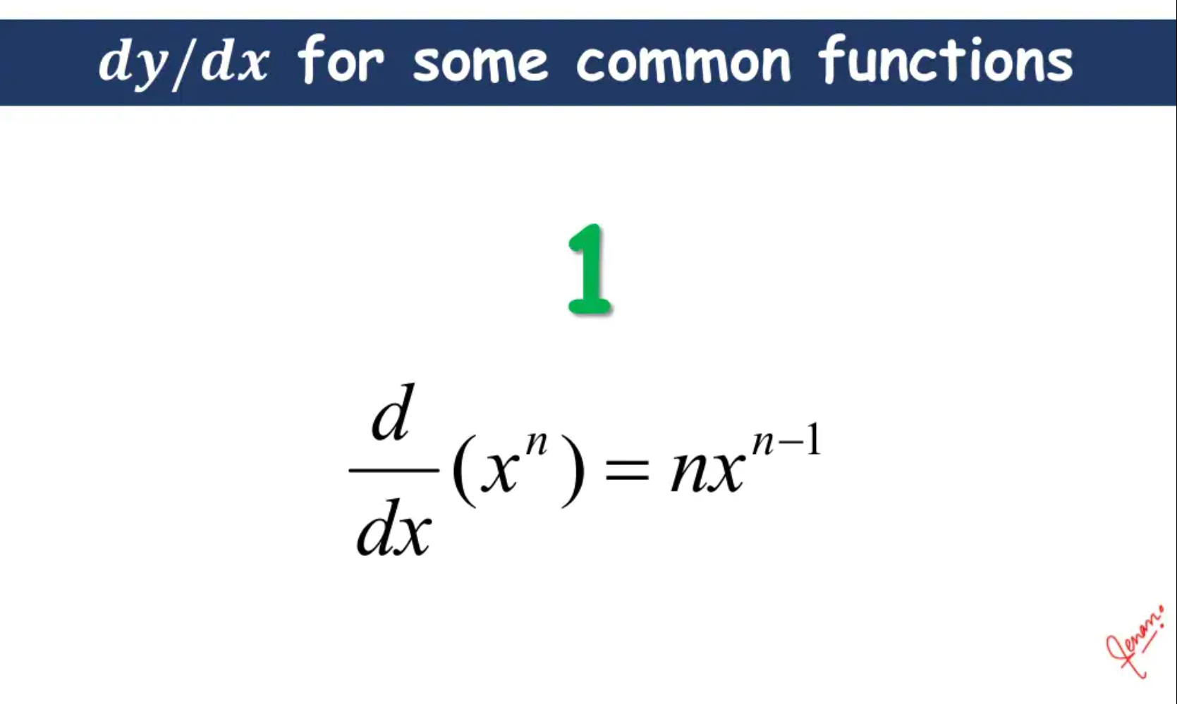

Slide 9
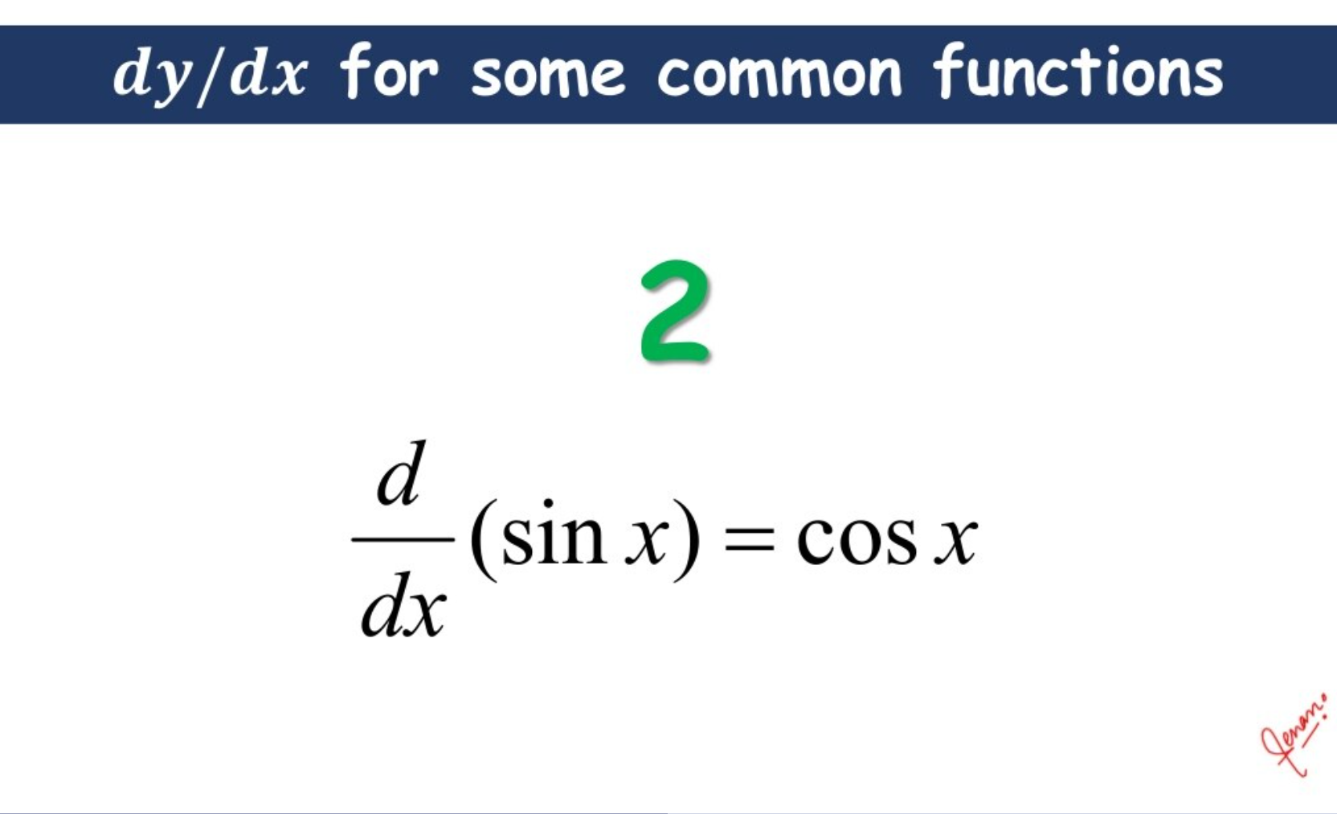

Slide 10
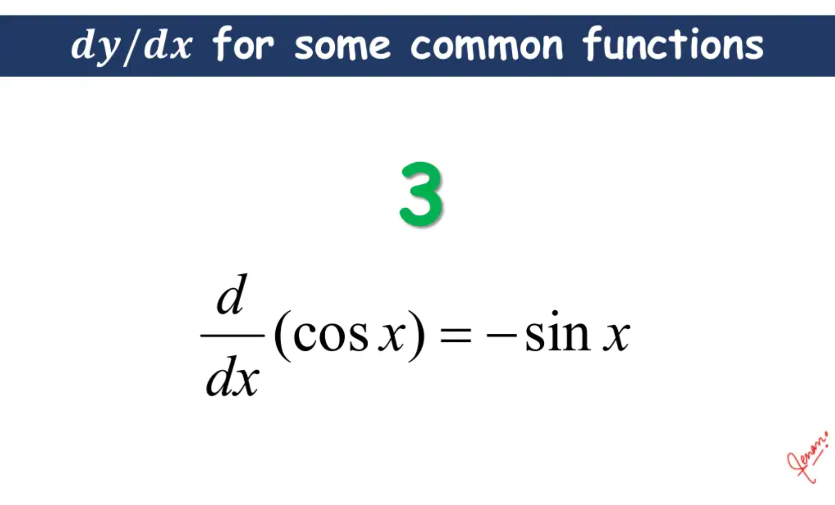

Slide 11
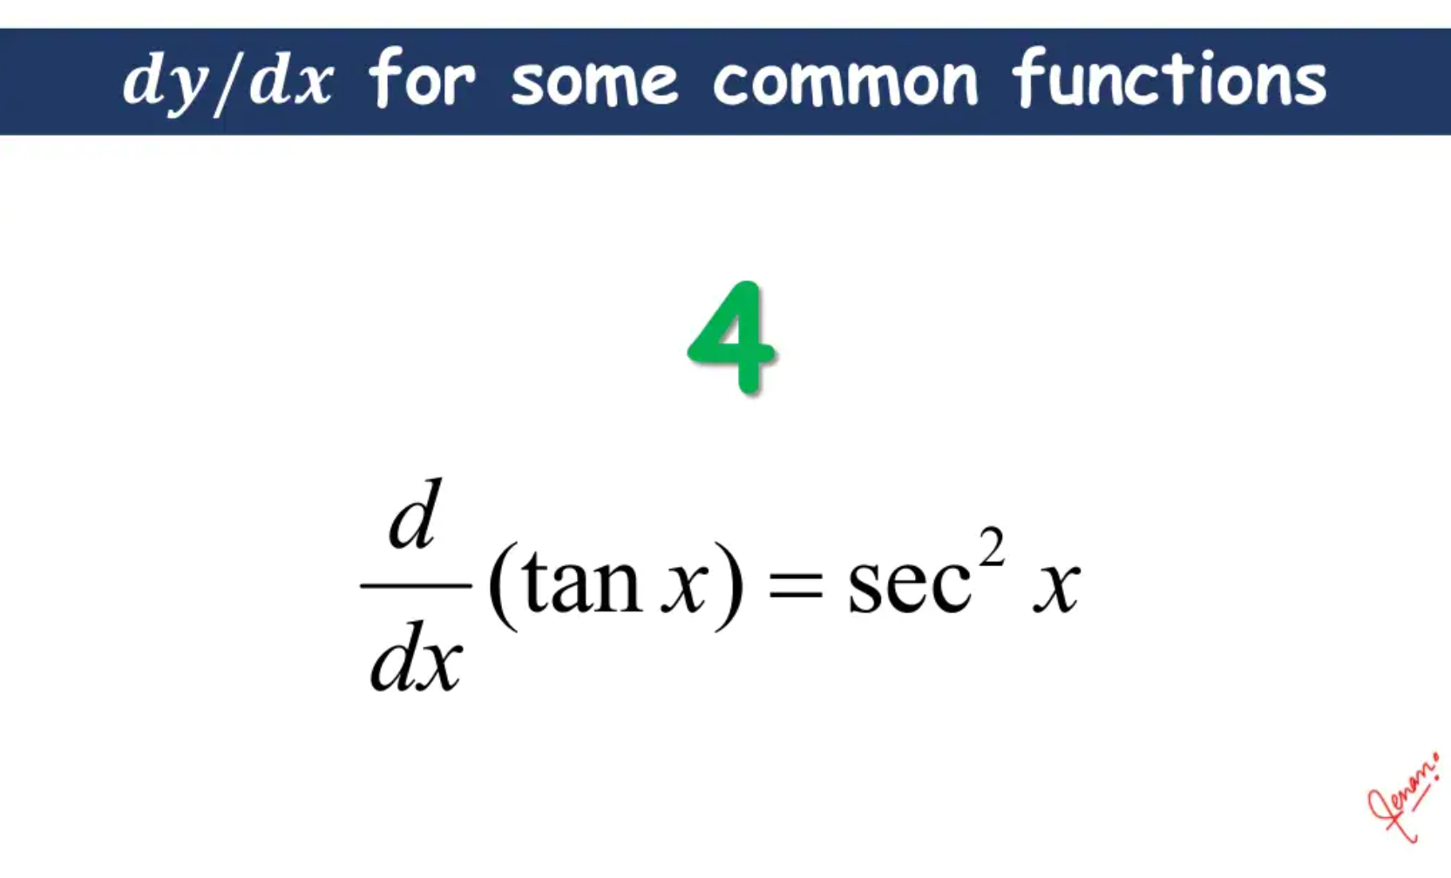

Slide 12
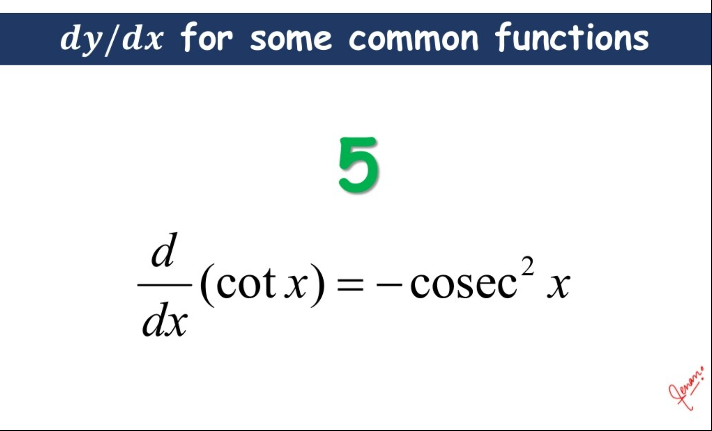

Slide 13
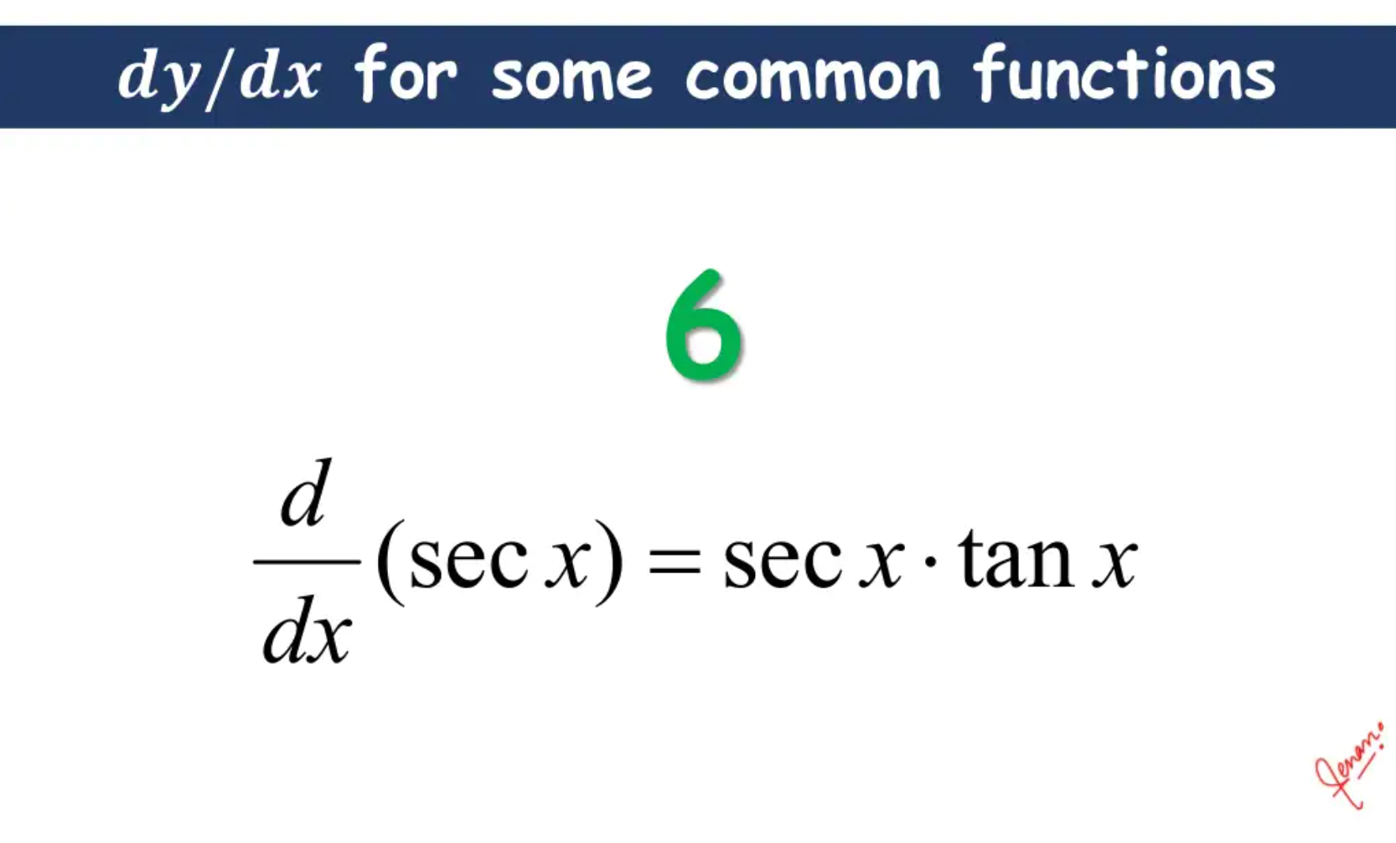

Slide 14
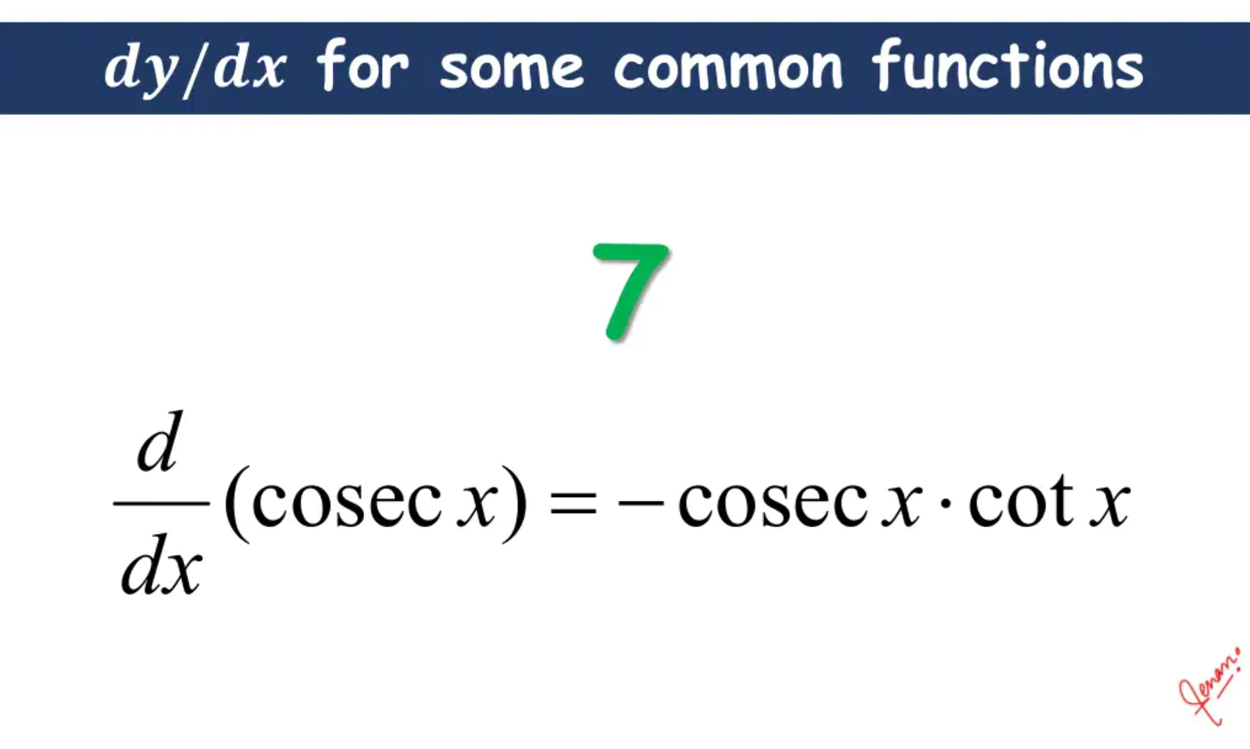

Slide 15
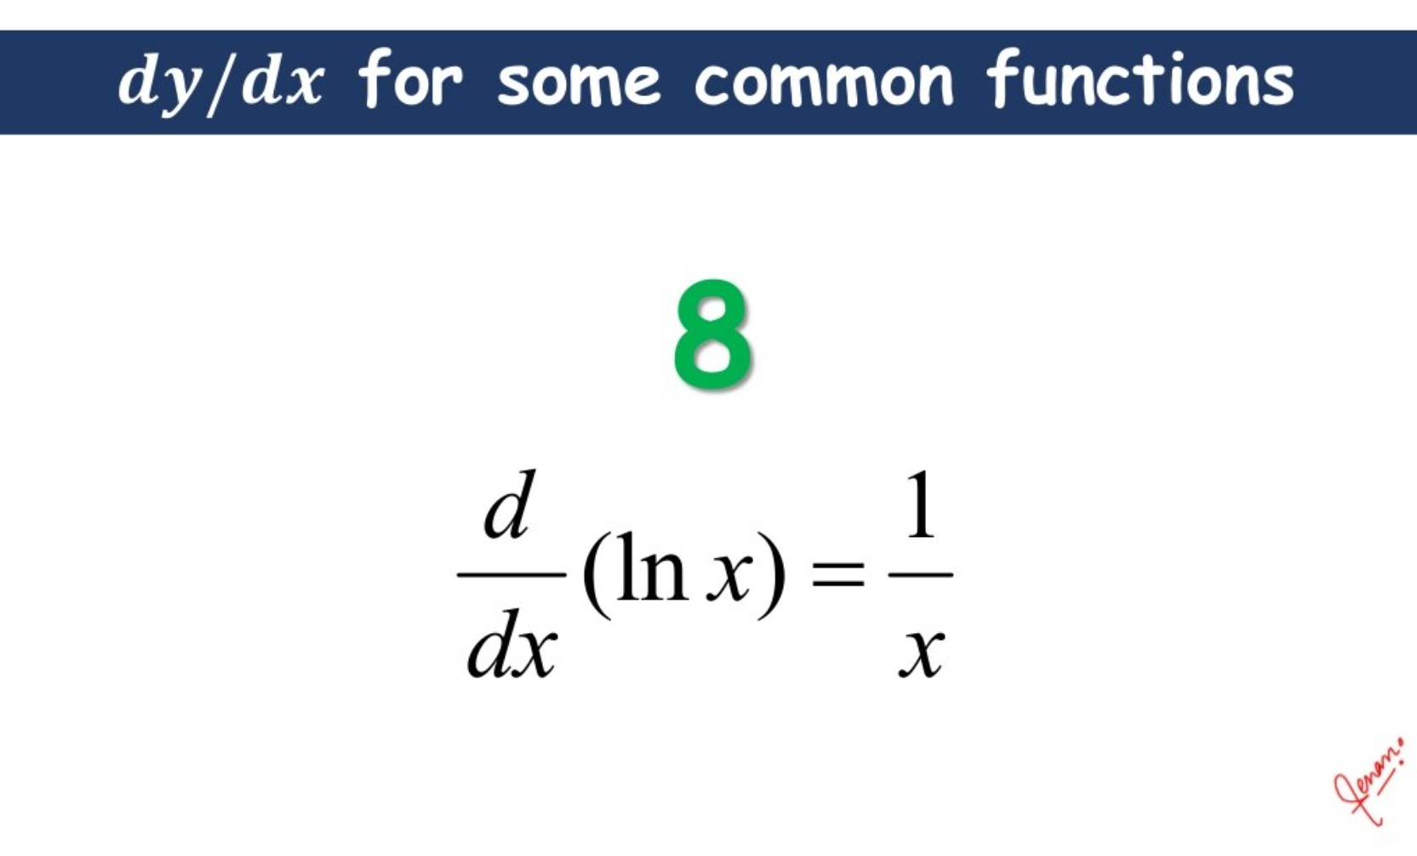

Slide 16
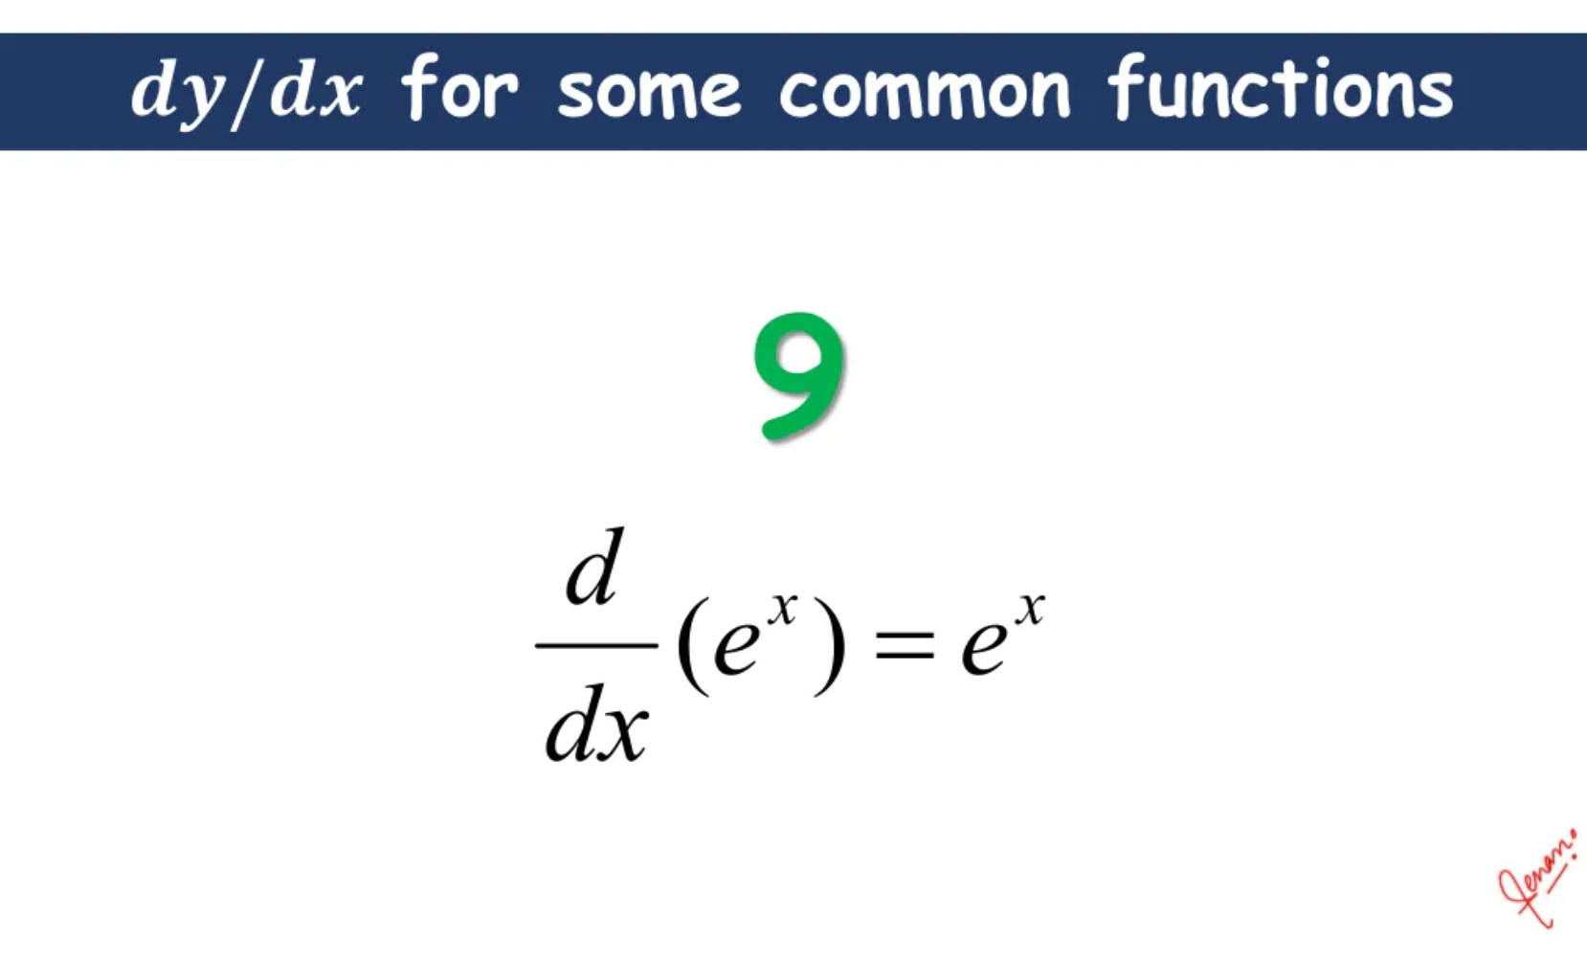

Slide 17
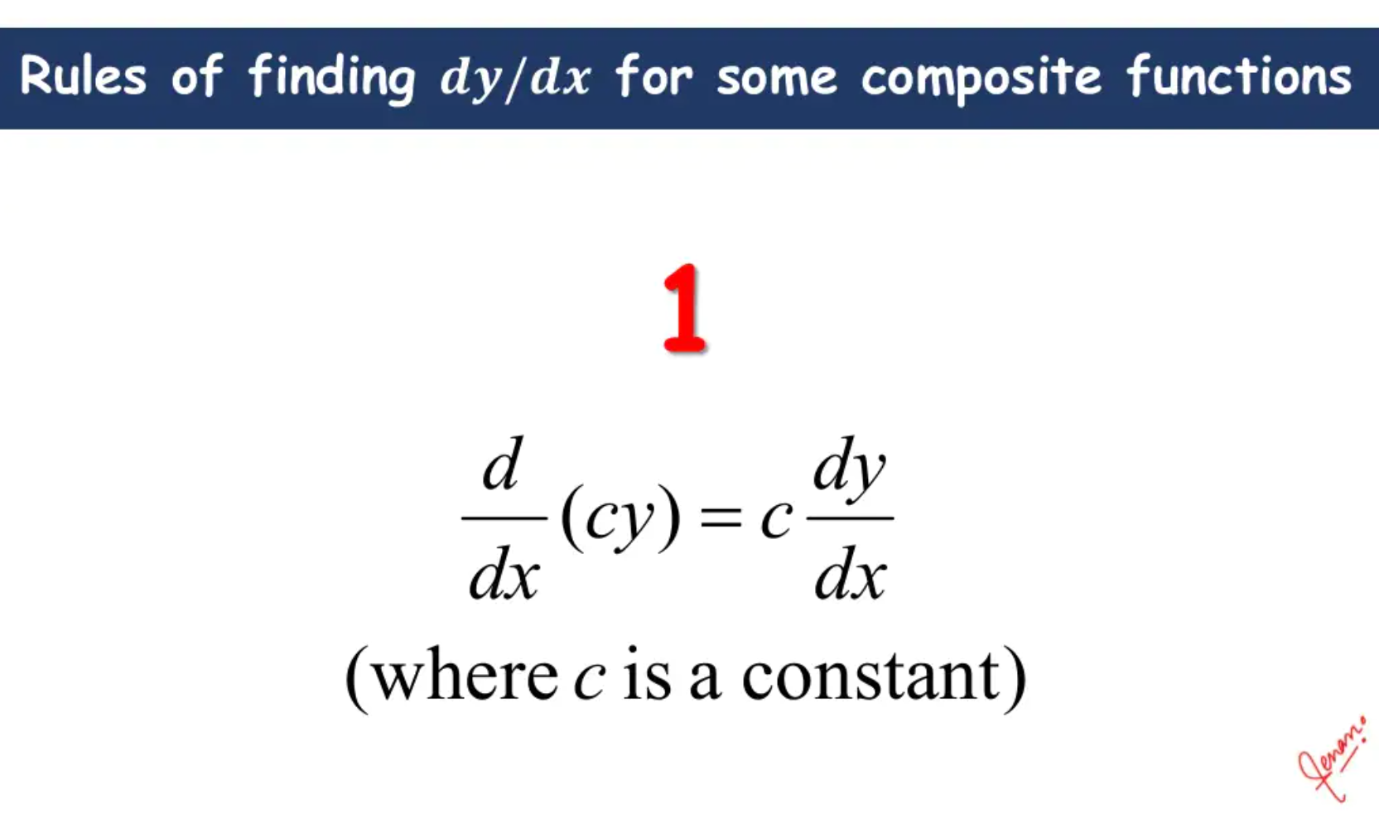

Slide 18
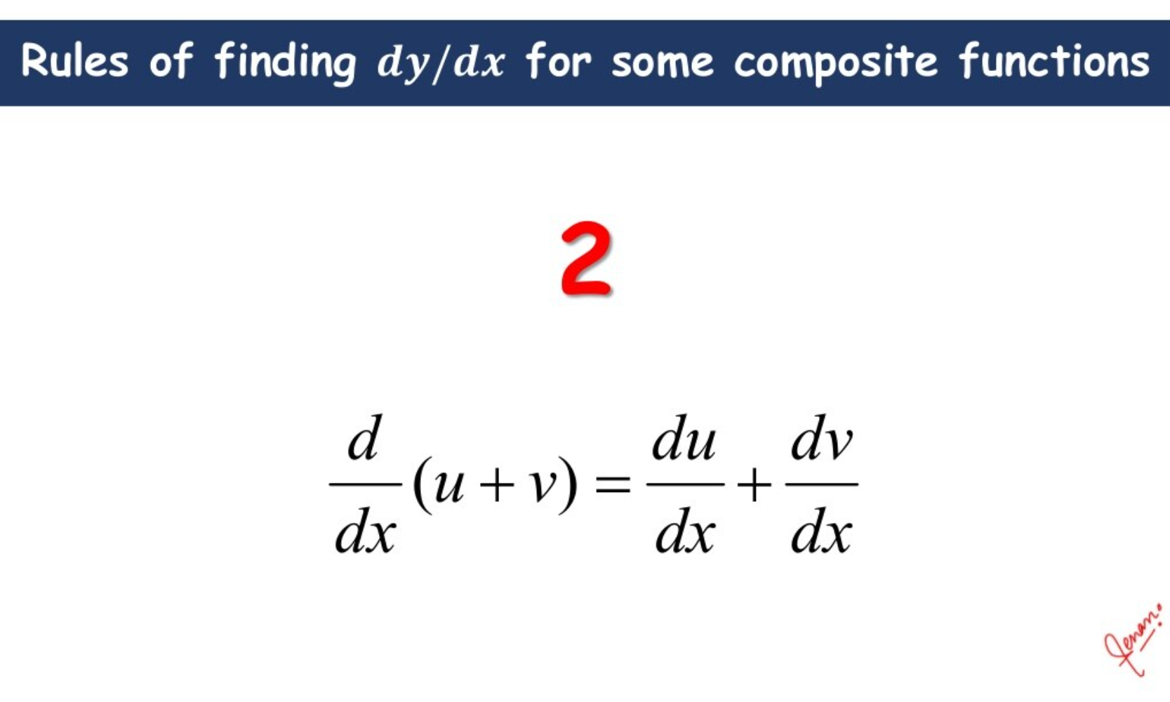

Slide 19
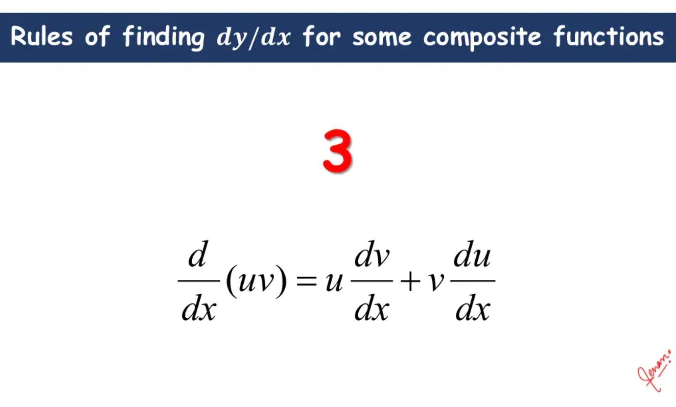

Slide 20
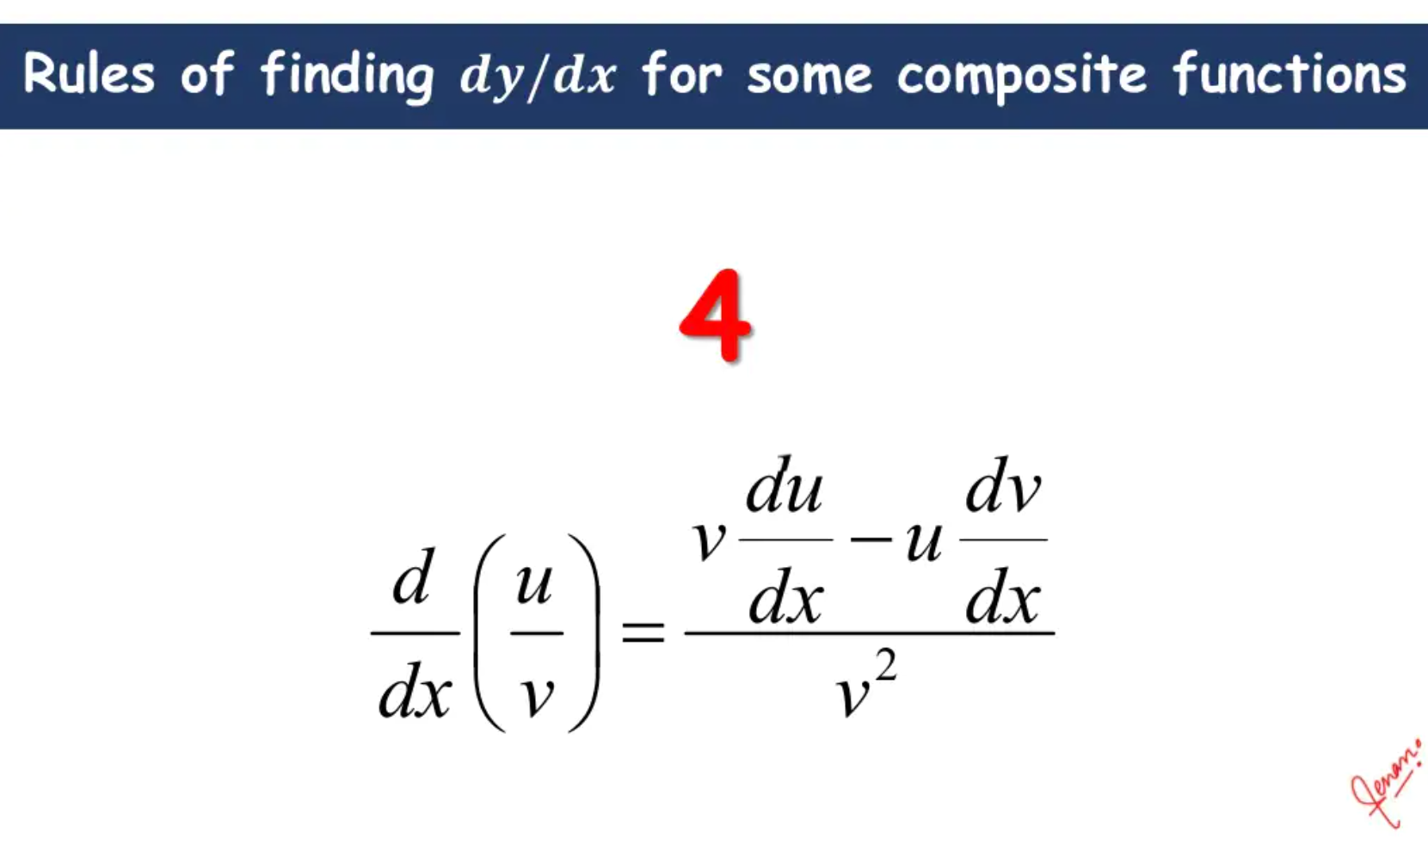

Slide 21
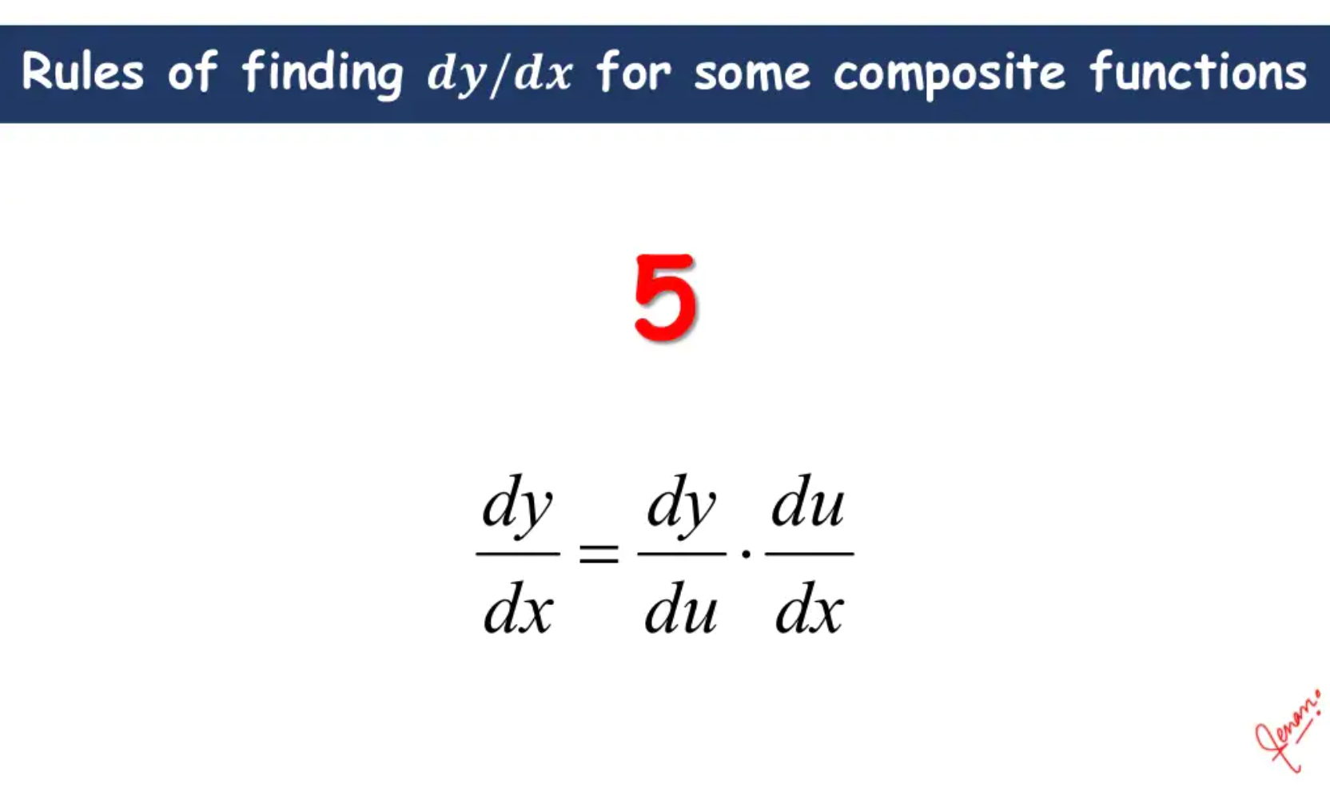

Slide 22
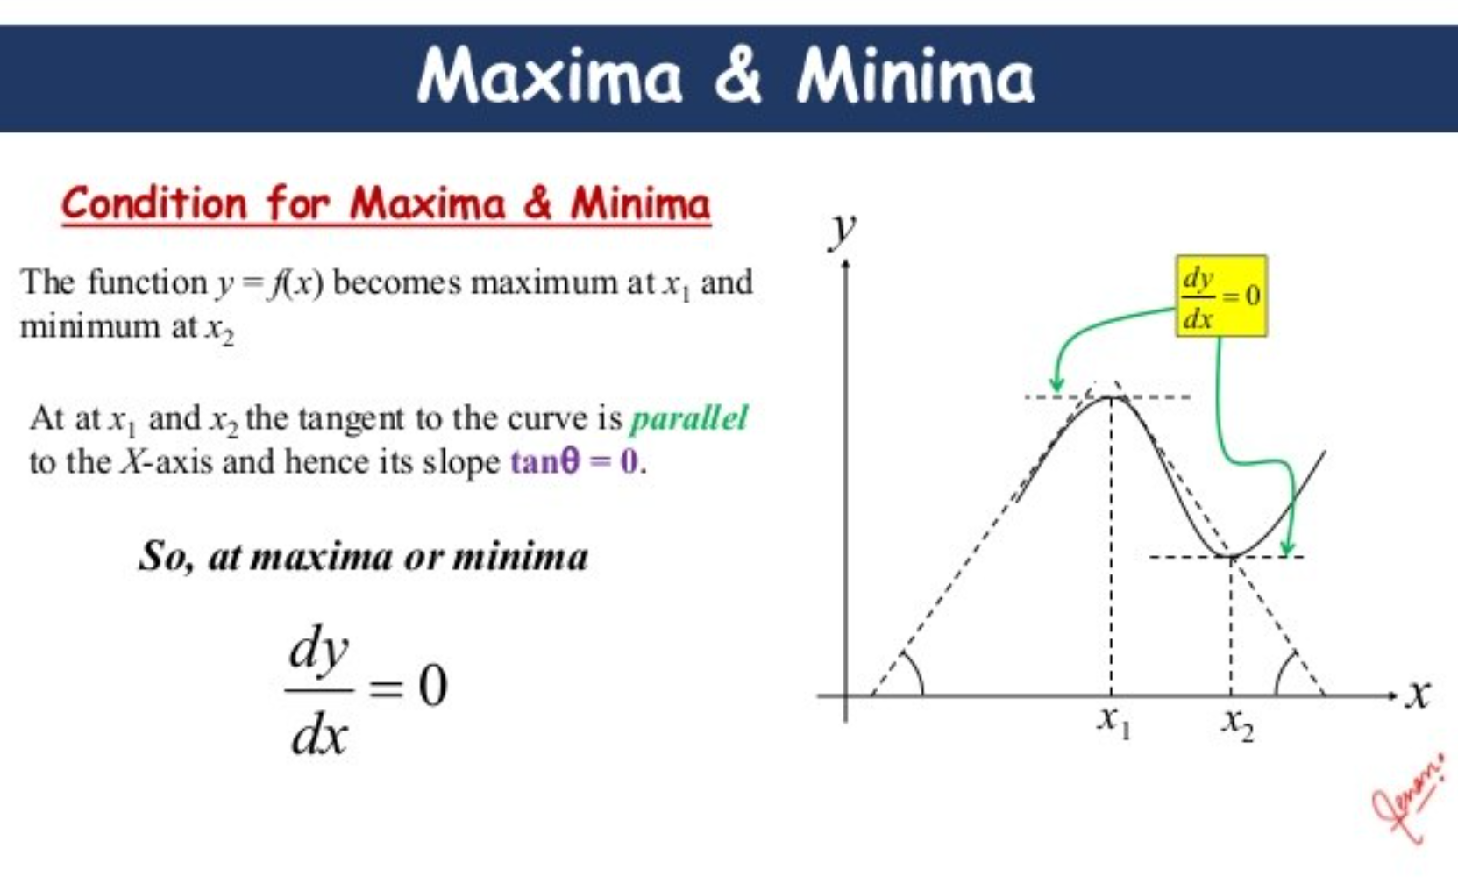

Slide 23
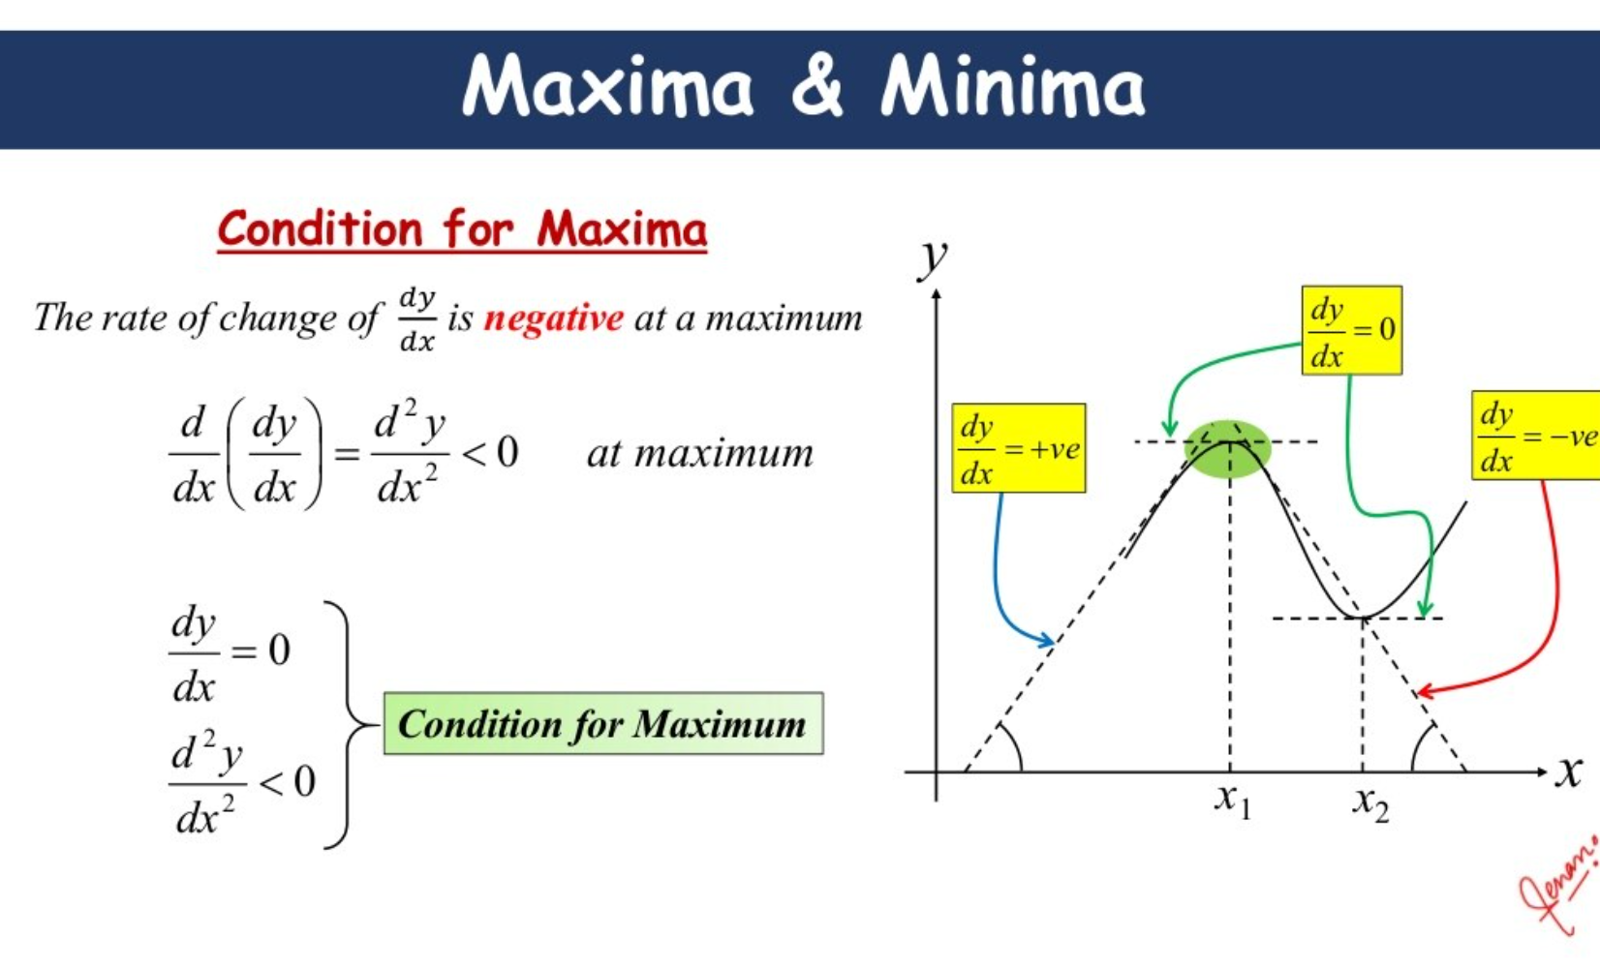

Slide 24
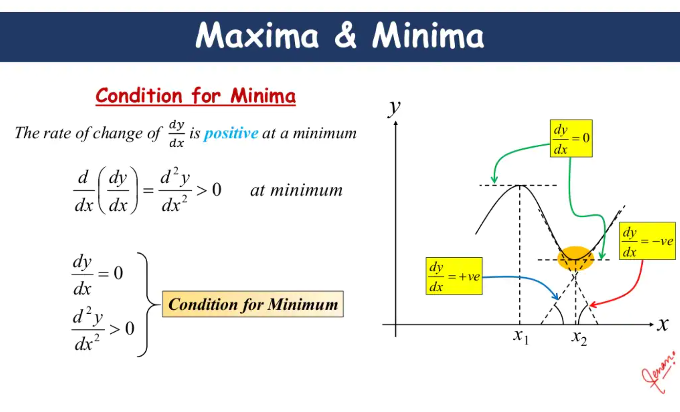

Slide 25
Requirement Data
x₁ | x₂ | y
1 | 2 | 3
Let’s understand how Model will use input features (x₁, x₂) and learn to predict y

Slide 26
Hidden Layer
Input
Output
1
2
Using a simple neural network with 1 hidden layer

Slide 27
Hidden Layer
W₁₁₁ =0.5
Input
W₁₁₂ =0.3
Output
1
2
Let’s calculate output for 1st Neuron in hidden layer

Slide 28
h₁₁ = xW + b
W₁₁₁ =0.5
Input
W₁₁₂ =0.3
Output
1
2

Slide 29
h₁₁ = 1 * 0.5 + 2 * 0.3 + 1
W₁₁₁ =0.5
Input
W₁₁₂ =0.3
Output
1
2
Initializing each weight with random numbers and bias with 1 (can be any number)

Slide 30
h₁₁
2.1
W₁₁₁ =0.5
Input
W₁₁₂ =0.3
Output
1
2

Slide 31
h₁₁
2.1
o₁₁ = sigmoid(h₁₁)
W₁₁₁ =0.5
Input
W₁₁₂ =0.3
Output
1
2
Apply activation (sigmoid) to Neuron’s output

Slide 32
h₁₁
2.1
o₁₁ = 0.89
W₁₁₁ =0.5
Input
W₁₁₂ =0.3
Output
1
2

Slide 33
h₁₁
2.1
o₁₁ = 0.89
W₁₁₁ = 0.5
Input
W₁₁₂ =0.3
h₂₁
Output
1
2
W₁₂₁ = 0.15
1.95
o₁₂ = 0.875
W₁₂₂ = 0.4
Repeat calculations for 2nd neuron...

Slide 34
h₁₁
2.1
o₁₁ = 0.89
W₁₁₁ = 0.5
Input
W₁₁₂ =0.3
h₂₁
Output
1
2
W₁₂₁ = 0.15
1.95
o₁₂ = 0.875
W₁₂₂ = 0.4
W₁₃₁ = 0.65
h₁₃
1.05
W₁₃₂ = -0.3
o₁₃ = 0.741
...and 3rd Neuron

Slide 35
h₁₁
2.1
o₁₁ = 0.89
W₁₁₁ = 0.5
W₁₁₂ =0.3
Output = 0.89* -0.23 + 0.875 * 0.83 + 0.741 * -0.56 + 1
Input
h₂₁
W₂₁₁ = -0.23
1
2
W₁₂₁ = 0.15
1.95
o₁₂ = 0.875
W₂₁₂ = 0.83
W₁₂₂ = 0.4
W₂₁₃ = -0.56
W₁₃₁ = 0.65
h₁₃
1.05
W₁₃₂ = -0.3
o₁₃ = 0.741
Initialize weights and bias for output layer and calculate output

Slide 36
h₁₁
2.1
o₁₁ = 0.89
W₁₁₁ = 0.5
Input
W₁₁₂ =0.3
h₂₁
W₂₁₁ = -0.23
Output
1
2
W₁₂₁ = 0.15
1.95
o₁₂ = 0.875
W₂₁₂ = 0.83
1.106
W₁₂₂ = 0.4
W₂₁₃ = -0.56
W₁₃₁ = 0.65
h₁₃
1.05
W₁₃₂ = -0.3
o₁₃ = 0.741
What’s next?

Slide 37
h₁₁
2.1
o₁₁ = 0.89
W₁₁₁ = 0.5
Input
W₁₁₂ =0.3
h₂₁
W₂₁₁ = -0.23
Output
1
2
Loss
W₁₂₁ = 0.15
1.95
o₁₂ = 0.875
W₂₁₂ = 0.83
1.106
(Prediction - Actual)²/2
W₁₂₂ = 0.4
W₂₁₃ = -0.56
W₁₃₁ = 0.65
h₁₃
1.05
W₁₃₂ = -0.3
o₁₃ = 0.741
Calculate Loss

Slide 38
h₁₁
2.1
o₁₁ = 0.89
W₁₁₁ = 0.5
Input
W₁₁₂ =0.3
h₂₁
W₂₁₁ = -0.23
Output
1
2
Loss
W₁₂₁ = 0.15
1.95
o₁₂ = 0.875
W₂₁₂ = 0.83
1.106
(1.106 - 3)²/2
= 1.793
W₁₂₂ = 0.4
W₂₁₃ = -0.56
W₁₃₁ = 0.65
h₁₃
1.05
W₁₃₂ = -0.3
o₁₃ = 0.741
Forward Propagation i.e starting with Input features, calculate Loss

Slide 39

How do we update weights?

Slide 40
h₁₁
2.1
o₁₁ = 0.89
W₁₁₁ = 0.5
Input
W₁₁₂ =0.3
h₂₁
W₂₁₁ = -0.23
Output
1
2
Loss
W₁₂₁ = 0.15
1.95
o₁₂ = 0.875
W₂₁₂ = 0.83
1.106
1.793
W₁₂₂ = 0.4
W₂₁₃ = -0.56
W₁₃₁ = 0.65
h₁₃
1.05
W₁₃₂ = -0.3
o₁₃ = 0.741
Minimizing Loss using Gradient Descent

Slide 41
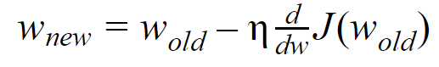
Gradient Descent
Calculate Gradient for Loss w.r.t each Weight and Bias in the Neural Network

Slide 42
h₁₁
2.1
o₁₁ = 0.89
W₁₁₁ = 0.5
Input
W₁₁₂ =0.3
h₂₁
W₂₁₁ = -0.23
Output
1
2
Loss
W₁₂₁ = 0.15
1.95
o₁₂ = 0.875
W₂₁₂ = 0.83
1.106
1.793
W₁₂₂ = 0.4
W₂₁₃ = -0.56
W₁₃₁ = 0.65
h₁₃
1.05
W₁₃₂ = -0.3
o₁₃ = 0.741
We start with Weights nearest to Output Layer e.g. W₂₁₁

Slide 43
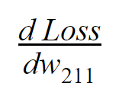
How is Loss related to w₂₁₁?

Slide 44
h₁₁
2.1
o₁₁ = 0.89
W₁₁₁ = 0.5
Input
W₁₁₂ =0.3
h₂₁
W₂₁₁ = -0.23
Output
1
2
Loss
W₁₂₁ = 0.15
1.95
o₁₂ = 0.875
W₂₁₂ = 0.83
1.106
1.793
W₁₂₂ = 0.4
W₂₁₃ = -0.56
W₁₃₁ = 0.65
h₁₃
1.05
W₁₃₂ = -0.3
o₁₃ = 0.741
Loss is dependent on Output, Output is dependent on W₂₁₁

Slide 45
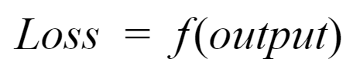
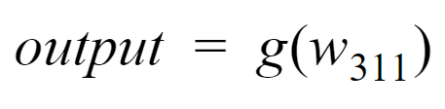
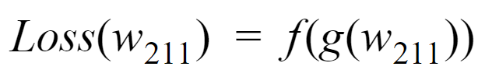

Slide 46
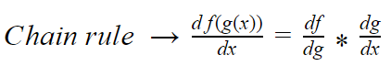
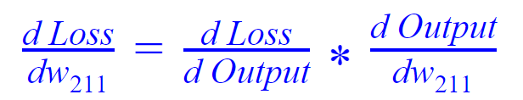
Let’s calculate each Gradient term individually

Slide 47
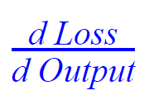
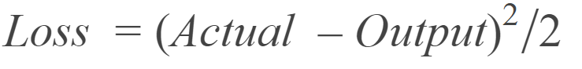
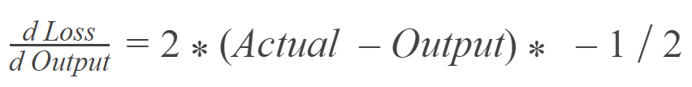
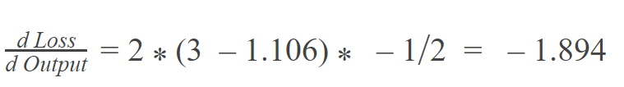

Slide 48
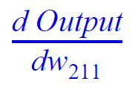
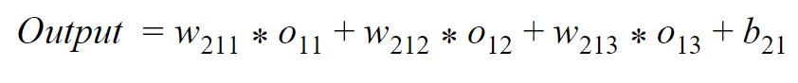
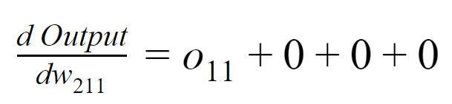
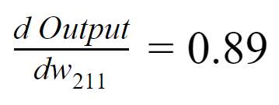

Slide 49
-1.894 * 0.89
= -1.686
What will be new value of w₂₁₁?

Slide 50
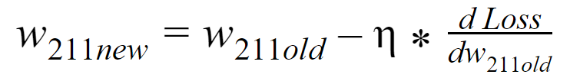
Learning rate (assume 0.01 here)
= -0.23 - 0.01 * -1.686
= -0.213

Slide 51
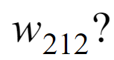
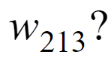
Calculate both in same way as W₂₁₁

Slide 52
h₁₁
2.1
o₁₁ = 0.89
W₁₁₁ = 0.5
Input
W₁₁₂ =0.3
h₂₁
W₂₁₁ = -0.23
Output
1
2
Loss
W₁₂₁ = 0.15
1.95
o₁₂ = 0.875
W₂₁₂ = 0.83
1.106
1.793
W₁₂₂ = 0.4
W₂₁₃ = -0.56
W₁₃₁ = 0.65
h₁₃
1.05
W₁₃₂ = -0.3
o₁₃ = 0.741
Updating weight for hidden layer e.g W₁₁₁

Slide 53
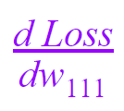
How is Loss related to w₁₁₁?

Slide 54
h₁₁
2.1
o₁₁ = 0.89
W₁₁₁ = 0.5
Input
W₁₁₂ =0.3
h₂₁
W₂₁₁ = -0.23
Output
1
2
Loss
W₁₂₁ = 0.15
1.95
o₁₂ = 0.875
W₂₁₂ = 0.83
1.106
1.793
W₁₂₂ = 0.4
W₂₁₃ = -0.56
W₁₃₁ = 0.65
h₁₃
1.05
W₁₃₂ = -0.3
o₁₃ = 0.741
W₁₁₁ → h₁₁ → o₁₁ → Output → Loss

Slide 55
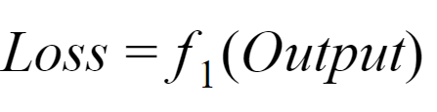
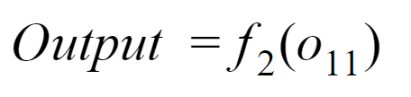
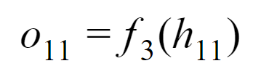
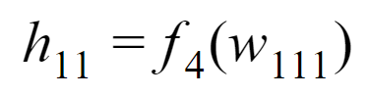

Slide 56
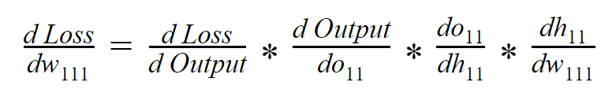
Using Chain Rule
Already calculated while calculating Gradient for Weights in Output Layer

Slide 57
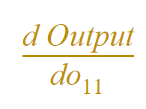
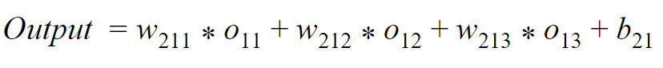

Gradient in Hidden Layer is dependent on Weights in Next Layers
-0.23

Slide 58



Activation (Sigmoid) function
NOTE!
Activation function should be Differentiable i.e it should be possible to calculate partial derivative of Activation function
0.89*(1-0.89)
=0.0979

Slide 59



1

Slide 60
-1.894 * -0.23 * 0.0979 * 1
= 0.0426

Slide 61
New value of w₁₁₁
= 0.5 - 0.01 * 0.0426
= 0.499
Calculate Gradients and perform Descent for other Weights in Hidden layer

